Slide 1
Chemistry 3A
Introductory General Chemistry
Word and Chemical Equations; Balancing Equations; Predicting Reactions: Single & Double Displacement; Writing Chemical Equations for Reactions in Solution; Complete Chemical, Complete Ionic, Net Ionic Equations; Oxidation/Reduction
S. M. Halloran

Slide 2
Word Equations
Chemical Equations
Balancing Equations
Predicting Reactions: Single & Double Displacement Reactions
Writing Chemical Equations for Reactions in Solution
  Complete Chemical Equations
  Complete Ionic Equations
  Net Ionic Equations
Oxidation/Reduction
  How to understand them and to apply them

Slide 3
Chemical Reactions & Conservation Laws
Chemical reactions are expressed in a way just as mathematics uses equations: to show something is connected at a time before with something that comes after
A reaction is an expression of substances that react—the reactants—and the result of the reaction—the products
Reactants → Products
The expression of these is about the conservation laws of mass (matter), energy, and electric charge

Slide 4
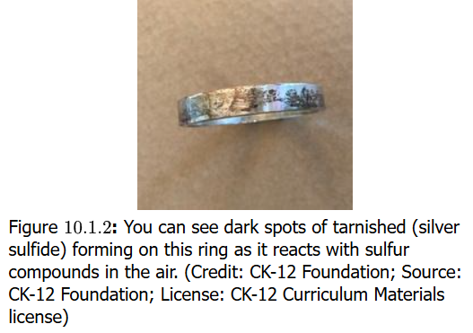
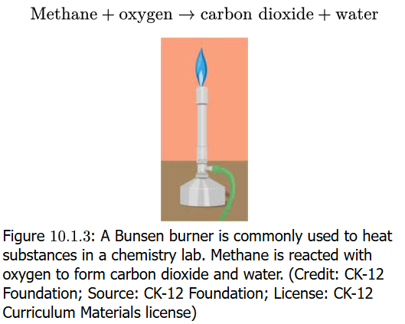
Equations in Words
Chemical reactions are expressed essentially as equations, and the expression can be in words
Silver metal solid is reacted with sulfur with the result it forms silver sulfide
  If you have ever seen tarnish
  on silver metal set, you see
  silver sulfur compound
  When natural gas (methane) is
  burned in a Bunsen burner,
  the gas reacts with oxygen (O₂) in
  the air to produce carbon dioxide
  (CO₂) and water (H₂O)
A problem with equations as words
is that they can not indicate
the quantitative nature of reactions
See also https://youtu.be/vTq4sgGd2QU

Slide 5
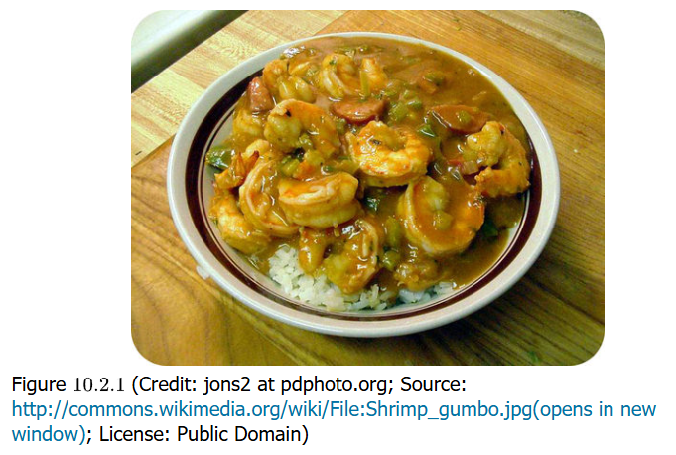
Steps in Chemistry = Recipe
Yum! Yum!
Your book wants to
point out that steps
in laboratory work such
as a chemical synthesis
align with a metaphor
of making a delicious
preparation of shrimp gumbo
Chemists are probably good in the kitchen as well because they must carefully, meticulously gather the ingredients and then “cook” them in the correct way to get an exacting result

Slide 6
Chemical Equations
Chemical equations start with using chemical formula which express matter as the symbols of the elements of the Periodic Table
The reactants and products as compounds are a sketch of the reaction. This is the skeleton equation
CH₄ + O₂ → CO₂ + H₂O
The next step is to indicate the physical state of the compounds:
CH₄ (g) + O₂ (g) → CO₂ (g) + H₂O (l)
(s) = solid, (l) = liquid, (g) = gas,
(aq) = compound in aqueous phase

Slide 7
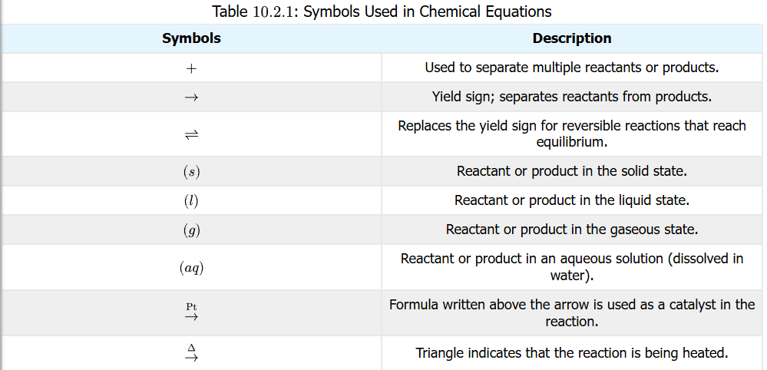
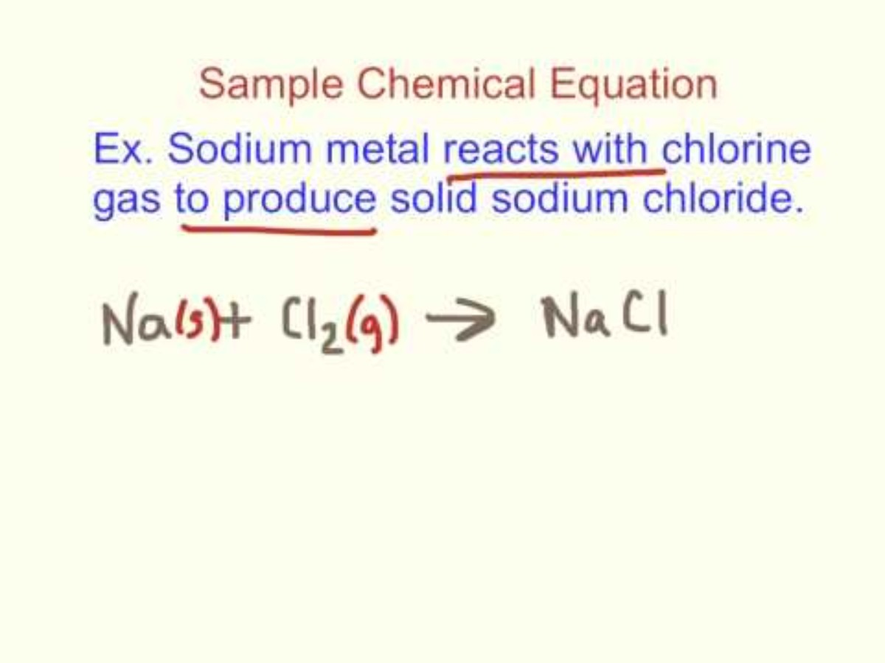
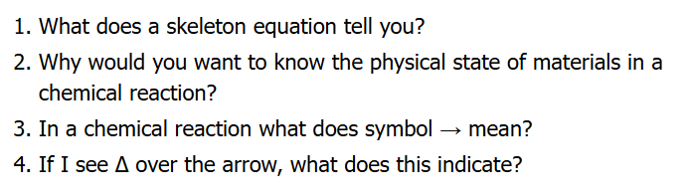
Symbols in Chemical Equations
It is important to understand the symbols used in chemical reaction equations

Slide 8
Balancing Equations
With the skeleton equation up on the whiteboard, it is time to apply the laws of the conservation of mass (electric charge & energy can be examined later)
One of the most important beginnings in chemistry is writing reactions (equations) that show the formation of compounds from their elemental forms
practice exercises calculating the enthalpy of formation is often seen with this
The elemental form of carbon is C (s). The elemental form of hydrogen is H₂ (g)
From these two, the formation of methane CH₄ (g) is shown
C (s) + H₂ (g) → CH₄ (g)
The equation is missing mass balance however, which it must have on both sides of the reaction arrow
There is one atom of C on both sides, so that’s OK, but there are 2 atoms of H on left side, but 4 atoms on the right. The left needs 2 more atoms, which can be done by doing the following:
C (s) + 2 H₂ (g) → CH₄ (g)

Slide 9
Details of Balancing Equations
In the previous slide, a 2 was added to the H₂ (g) reactant to achieve the balance of atoms on both sides of the reaction arrow
C (s) + 2 H₂ (g) → CH₄ (g)
This 2 and any whole number/integer placed in front of a chemical compound in a chemical equation is called a coefficient
This is also term in mathematics for a number placed in front
of a variable in an algebraic expression
Putting a coefficient in front of a compound has the effect of multiplying the number of each atom in the compound by the number of the coefficient, and if the atom is subscripted, by that subscript number too
2 H₂ = 2 x 2 H = 4 H atoms
2 CO₂ = 2 x 1 C = 2 C atoms; 2 x 2 O = 4 O atoms
4 H₂O = 4 x 2 H = 8 H atoms; 4 x 1 O = 4 O atoms
3 MnO₄ = 3 x 1 Mn = 3 Mn atoms; 3 x 4 O = 12 O atoms

Slide 10
Steps To Balancing Equations
Set up the skeleton equation: write down the correct chemical formulas on each side of the reaction arrow, the reactants and products
Identify all atoms and count the number of atoms on the reactant and product side
If polyatomic ions are unchanged on both sides, count it as a unit
Begin the balancing by focusing on elements that occur in only one compound on one side
  For instance, oxygen often in appears in more than one compound on one side the arrow: do not start with balancing oxygen atoms
Balancing can ONLY be done by using coefficients: changing subscripts changes the chemical nature of a compound, and this is not permitted
When satisfied of completion, verify the numbers of atoms on both sides of reaction arrow
Make sure coefficients have lowest possible ratio, while remaining integers

Slide 11
Practice Balancing Equations
An aqueous solution of lead(II) nitrate and sodium chloride are mix, resulting in a precipitate of lead(II) chloride and sodium nitrate. Show the balanced chemical reaction equation
Write equation using correct chemical formula subscripts and phases:
Pb(NO₃)₂ (aq) + NaCl (aq) → PbCl₂ (s) + NaNO₃ (aq)
Identify atoms and count number of atoms in reactants and products:
Reactants: 1 Pb²⁺, 2 NO₃–, 1 Na⁺, 1 Cl–
Products: 1 Pb²⁺, 2 Cl–, 1 Na⁺, 1 NO₃–
Focus on balancing: only coefficients can be used (show logic):
Pb²⁺ and Na⁺ on both sides equal, but anions Cl– and NO₃– need adjusting; start with Cl–:
put 2 on reactant side: Pb(NO₃)₂ (aq) + 2 NaCl (aq) → PbCl₂ (s) + NaNO₃ (aq), now Cl balanced, but Na out of balance
Now NO₃–: Put 2 on products side: Pb(NO₃)₂ (aq) + 2 NaCl (aq) → PbCl₂ (s) + 2 NaNO₃ (aq), now balanced and Na also balanced
Verify work: atoms and their counts looked balance
Do coefficients have lower possible ratio? There are coefficients of 2 on some molecules: can divide by 2? No. Lowest possible ratio exists

Slide 12
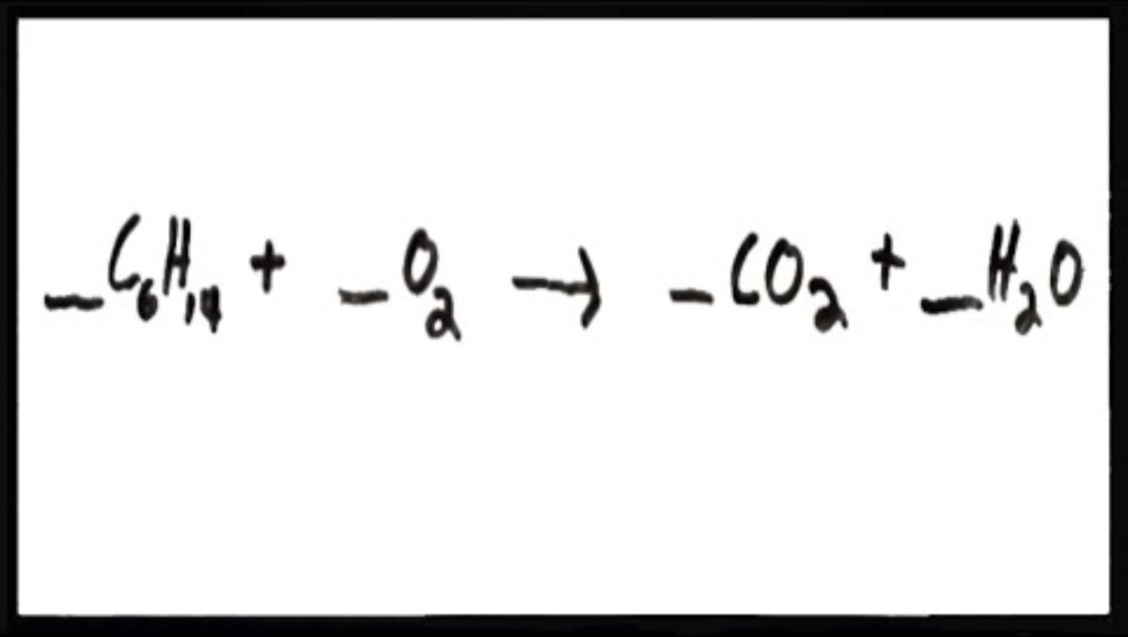
A simulation about balancing chemical equations
Also a video

Slide 13
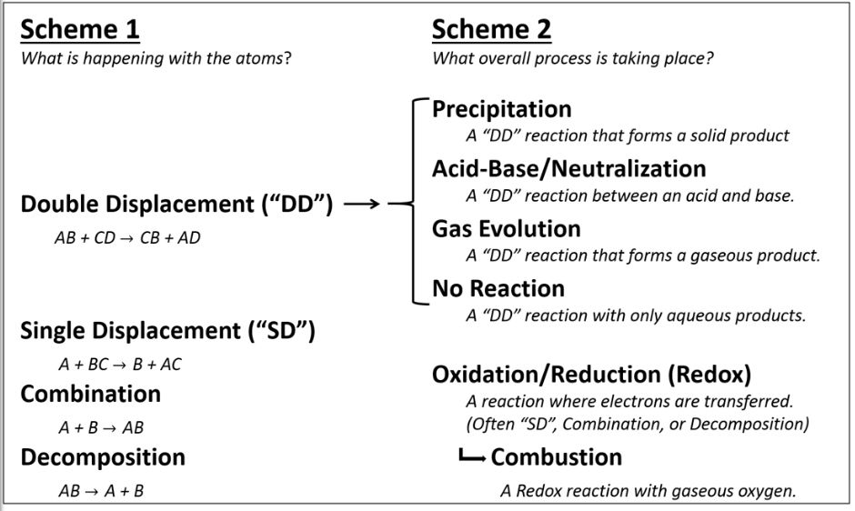
Types of Reactions
Chemical reactions will fall under certain types/categories on one level, and then on an additional level with question “what is happening with atoms?”
On an additional level, the question is “what process is
happening?”
You will learn
to identify
these types or
categories of
reactions

Slide 14
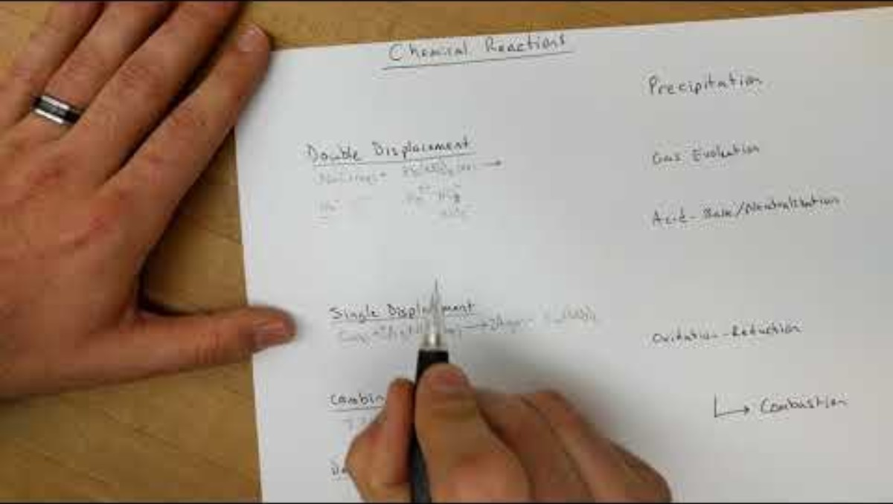
Types of Reactions

Slide 15

Combination Reactions
A + B → AB
This reaction type is about synthesis: two substances combine to form a single (third) compound
Sodium metal solid reacts with chlorine gas to form the solid sodium chloride
2 Na (s) + Cl₂ (g) → 2 NaCl (s)
  Video about magnesium (Mg)
  and oxygen (O₂). Our earlier
  “Empirical Formula” experiment
  did not expose Mg directly to flame

Slide 16
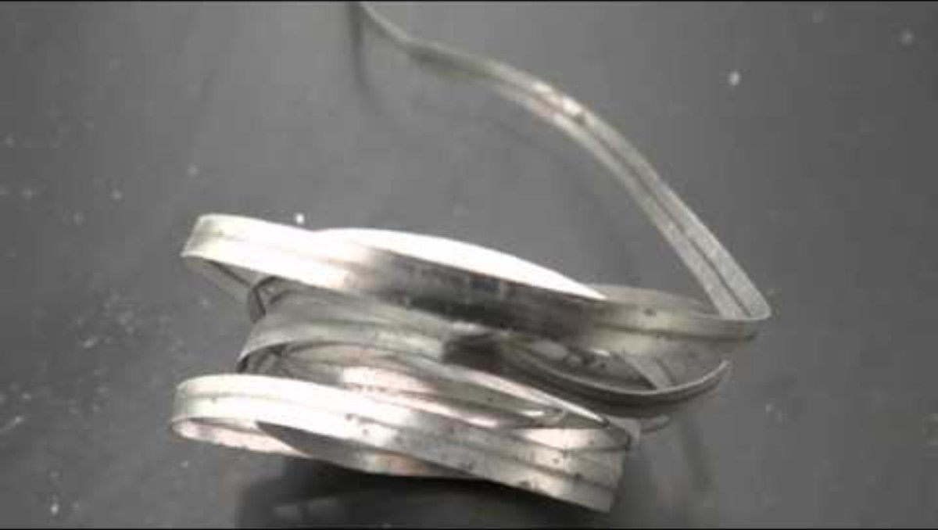
Oxide Formation: A Combination Reaction
Oxygen O₂ in the air reacting with numerous elements is perhaps one of the most important significant of reactions
2 Mg (s) + O₂ (g) → 2 MgO (s)
This reaction was one of your recent lab experiments!!
S (s) + O₂ (g) → SO₂ (g)
2 S (s) + 3 O₂ (g) → 2 SO₃ (g)
2 Fe (s) + O₂ (g) → 2 FeO (s)
4 Fe (s) + 3 O₂ (g) → 2 Fe₂O₃ (s)
4 K (s) + O₂ (g) → 2 K₂O (s)
Synthesis/Combination Reactions video

Slide 17
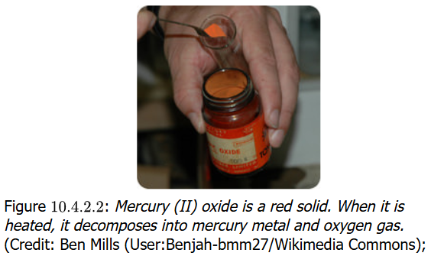
Decomposition Reactions
AB → A + B
The decomposition reaction type appears to be the very opposite of the combination reaction
One substance (shown as “parts” of A and B) is “decomposed” to form two or more substances/compounds
Many of these reactions
require an input of energy—
an “activation energy”—
for the reaction to proceed
2 HgO (s) → 2 Hg (l) + O₂ (g)
A compound decomposes to elements in this reaction

Slide 18
Decomposition Reactions
Decomposition reaction include compounds decomposing to compounds:
CaCO₃ (s) → CaO (s) + CO₂ (g)
Here metal oxides are formed from their hydroxides
2 NaOH (s) → Na₂O (s) + H₂O (l)
Acids like the unstable carbonic acid will decompose quickly to nonmetal oxides and water
H₂CO₃ (aq) → CO₂ (g) + H₂O (l)
Potassium chlorate is a well-known decomposition reaction
2 KClO₃ (s) → 2 KCl (s) + 3 O₂ (g)
The electrolysis of water is a well-known decomposition
H₂O (l) → H₂ (g) + O₂ (g)

Slide 19
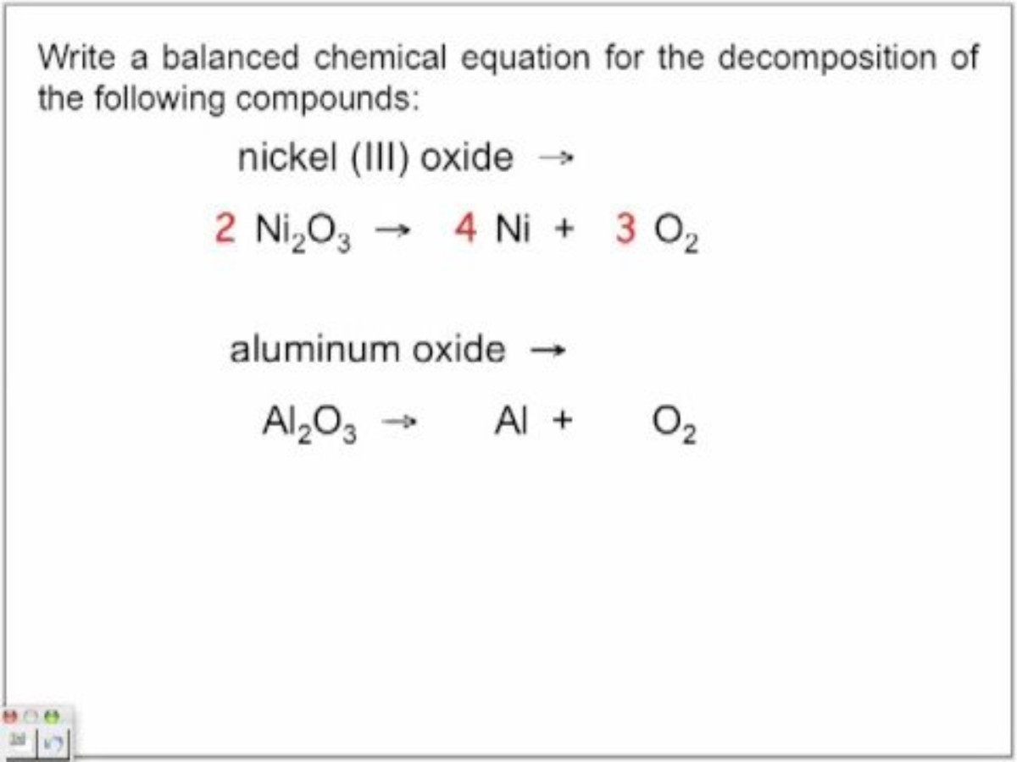
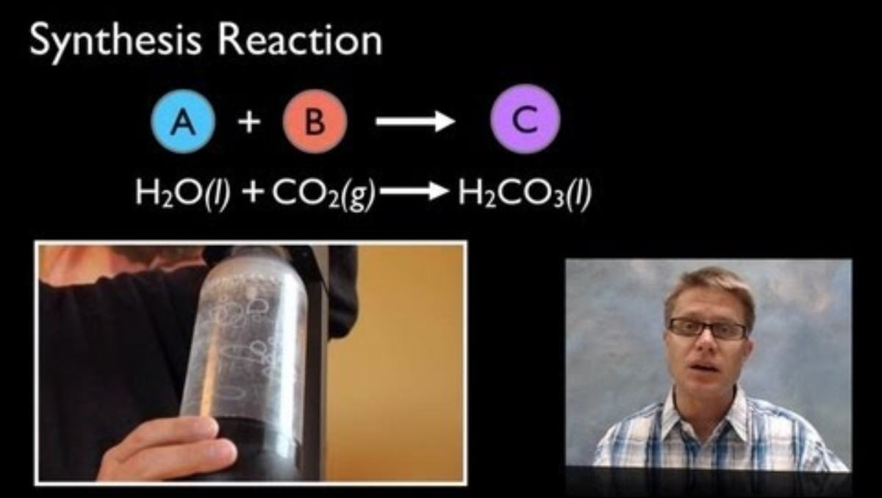
Decomposition Reactions
A simulation on a chemical reaction causing a vehicle accident airbag to suddenly inflate

Slide 20
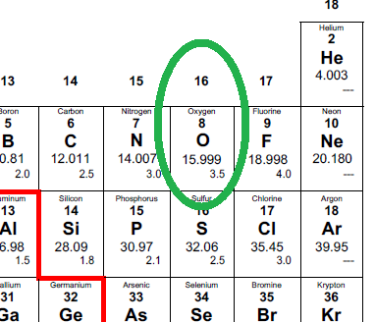
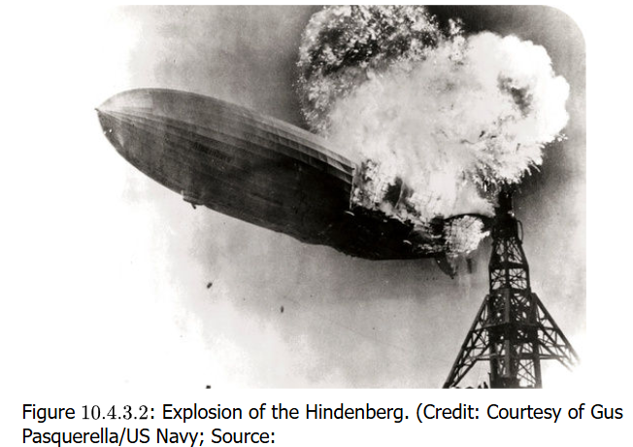
Combustion Reactions
X + O₂ (g) → XO_{n} + …
Combustion reactions always
involve gaseous oxygen (O₂)
as a reactant
Humans learned the hard way with the Hindenberg airship disaster that hydrogen gas (H₂) also gets combusted
2 H₂ (g) + O₂ (g) ➔ 2 H₂O (g)
Are you a gas griller? Here is the combustion of propane:
C₃H₈ (g) + 5 O₂ (g) → 3 CO₂ (g) + 4 H₂O (g)
Among the many important things to learn in chemistry, one of these is just how much oxygen is involved in much of chemistry

Slide 21
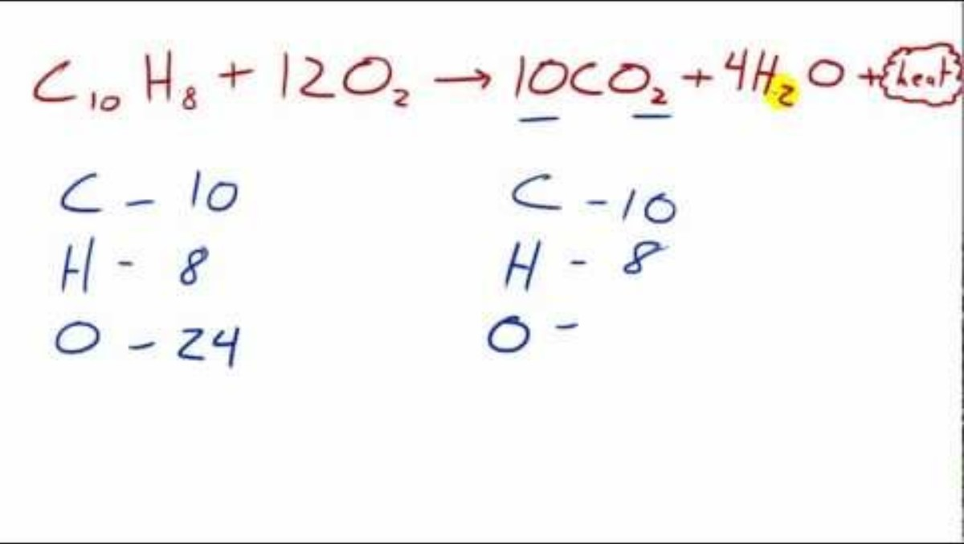
Combustion Reactions

Slide 22
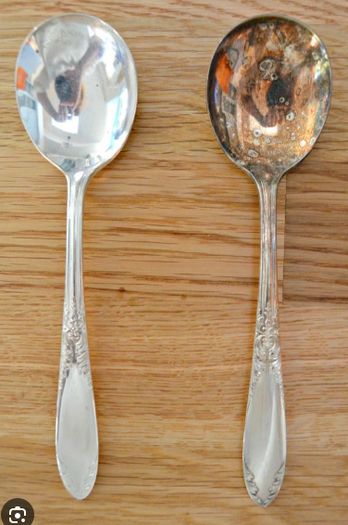
Single Replacement Reactions
Silver tarnishes. The metal reacts with
hydrogen sulfide (H₂S) which is always
present in small amounts in the air
2 Ag (s) + H₂S (g) → Ag₂S (s) + H₂ (g)
This is an example of a
single-replacement reaction
A + BC → AC + B
One (usually metal) element A
replaces a similar (also metal) element B in a compound
If A is a nonmetal, it will replace the nonmetal that is B with C

Slide 23
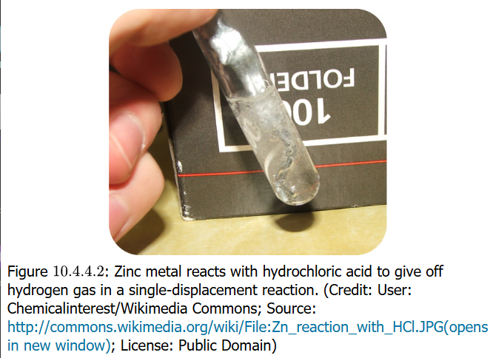
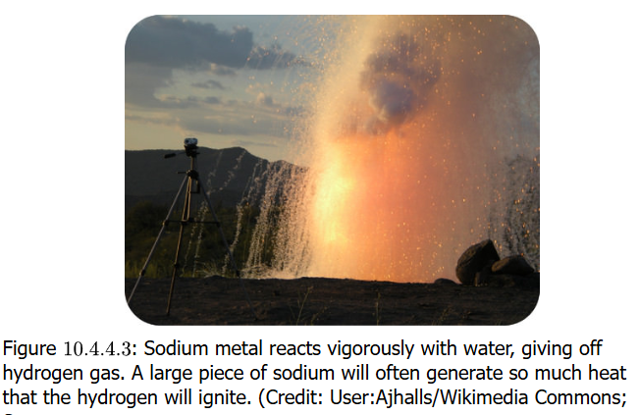
Single Replacement Reactions
Metal Replacement
Mg (s) + Cu(NO₃)₂ (aq) →
Mg(NO₃)₂ (aq) + Cu (s)
Mg more reactive than Cu and replaces it
Hydrogen Replacement
Zn (s) + 2 HCl (aq) →
ZnCl₂ (aq) + H₂ (g)
Acidic proton is replaced by active metal
Water is not usually considered an acid,
but some metals are so reactive that
they replace the H in H₂O to form the
metal hydroxide
2 Na (s) + 2 H₂O (l) → 2 NaOH (aq) + H₂ (g)

Slide 24
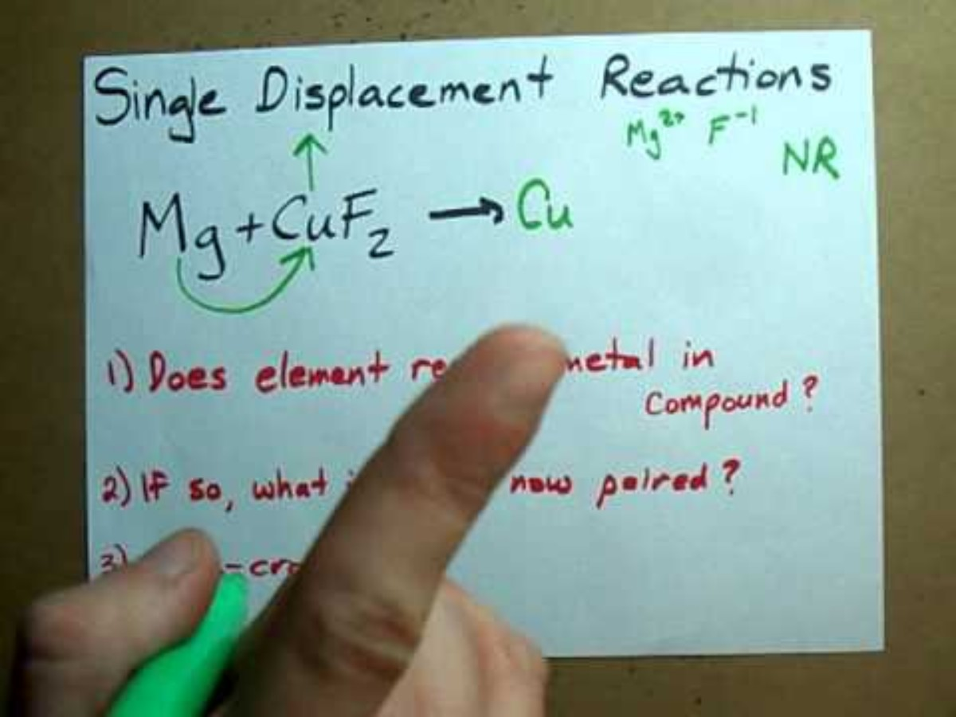
Single Replacement Reactions
Halogen Replacement
The interesting thing about this reaction is that diatomic chlorine molecule replaces bromine ion to produce chloride ion and diatomic bromine molecule (it actually takes electrons away from Br in an oxidation reaction)
Cl₂ (g) + 2 NaBr (aq) → 2 NaCl (aq) + Br₂ (l)
Cl₂ will do the same to NaI.
Fluorine (F₂) will do the same
to NaCl or NaBr or NaI.
And Br₂ will do the same to NaI.
All these elements are in same
Group (column), and they show
a reactivity based on the period
(row) they are in
Reactivity decreases
with increasing period

Slide 25
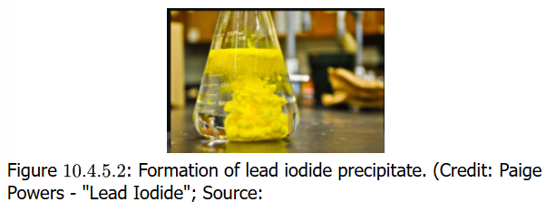
Double Replacement Reactions
AB + CD → AD + CB
This reaction is when the cations and anions of two ionic compounds exchange places to form two different ionic compounds
  A & C are the cations, B and D are the anions
  These reactions happen when one of the products is a precipitate, gas or a molecule like H₂O
Precipitate
2 KI (aq) + Pb(NO₃)₂ (aq) →
2 KNO₃ (aq) + PbI₂ (s)
Pb²⁺ and I⁻ ions strongly bind and form a solid

Slide 26
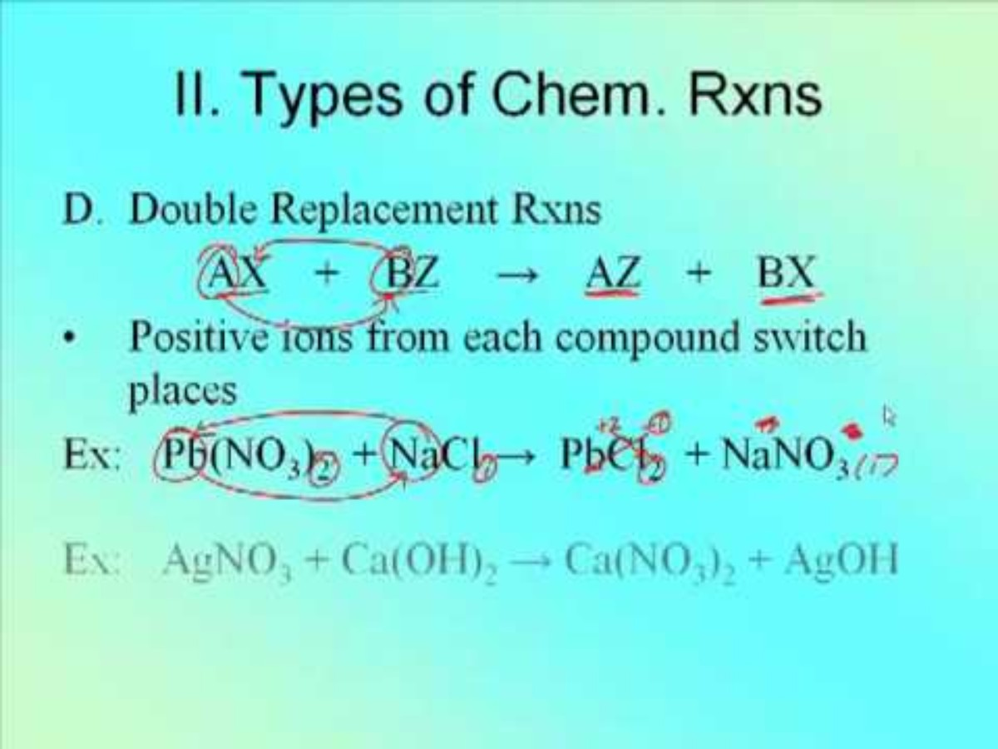
Double Replacement Reactions
Gas Formation
Na₂S (aq) + 2 HCl (aq) → 2 NaCl (aq) + H₂S (g)
The H₂S gas bubbling out actually drives the action further to the right, promoting the reaction
Molecular Compound Formation
HCl (aq) + NaOH (aq) → NaCl (aq) + H₂O (l)
This is actually a classic reaction
of a strong acid with a
strong base to produce
a salt and water

Slide 27
Predicting Single Displacement Reactions
The hydrogen and halogen single replacement reactions were discussed a couple of slides back
For ionic compounds, elements of the same type will replace elements of that type
  Metal cations/elements replace metal cations
  Nonmetal anions/elements replace nonmetal anions
FeCl₂ + Ca → ?
CaCl₂ + Fe
CaBr₂ + F₂ → ?
CaF₂ + Br₂
FeI₂ + Cl₂ → ?
FeCl₂ + I₂
AlPO₄ + Mg → ?
balanced should be: 2 AlPO₄ + 3 Mg → Mg₃(PO₄)₂ + 2 Al

Slide 28
Predicting Double Displacement Reactions
There are patterns and trends that can be seen with these reactions making them predictable
Exchange anions and cations on reactant side to form new product compounds
Since charge magnitude may differ on cations or anions (1+ and 2+, or 1– and 2–) between reactants and products, formulas may need to be corrected (remember the criss-cross method)
Balance the equation
Consider barium chloride (BaCl₂) and lithium sulfate (Li₂SO₄) next

Slide 29
Predicting Double Displacement Reactions
Exchange anions and cations on reactant side to form new product compounds
BaCl₂ (aq) + Li₂SO₄ (aq) → Ba(SO₄) + LiCl
In specifying the products, it is vital to follow write the correct chemical formula for compounds and not worry about balance of atom numbers on both sides of arrow at the moment
Polyatomic ions (like sulfate SO₄²⁻) despite being composed of multiple elements must be maintained as the groups of elements they are which gives them their identity as polyatomic ions as they are connected by covalent and not ionic bonds, despite being ions as a group of nonmetal elements

Slide 30
Predicting Double Displacement Reactions
Since charge magnitude may differ on cations or anions (1+ and 2+, or 1– and 2–) between reactants and products, formulas may need to be corrected (remember the criss-cross method)
BaSO₄ , LiCl
The exchanged ions Ba²⁺ with SO₄^{2–}, and of Li⁺ with Cl–, created no problem with matching charges of the ions: 1+ matched with 1– and 2+ matched with 2–
Had this matching not of ions by charge state not occurred, determining correct subscripts to monatomic ions or polyatomic ions would have been necessary

Slide 31
Predicting Double Displacement Reactions
Balance the equation
BaCl₂ (aq) + Li₂SO₄ (aq) → BaSO₄ (s) + 2 LiCl (aq)
At this point, the compounds are determined. Subscripts to monatomic or polyatomic ions will not be changed
To achieve balance, coefficients will be determined (added) to the compounds to obtain the necessary result
In the current reaction, it was only necessary to balance with two of the LiCl ionic compound

Slide 32
Practice: Predicting Double Replacement
Predict mixing of: RbOH (aq) + CoCl₂ (aq)
Exchange cations/anions
RbOH (aq) + CoCl₂ (aq) → RbCl + Co(OH)
Note that hydroxide is parenthesized to show as a polyatomic ion it should not have its elements separated
Adjust formulas (subscripts) of products to correct for ion charge states
RbOH (aq) + CoCl₂ (aq) → RbCl + Co(OH)₂
RbCl needed no correction because rubidium is a 1+ ion and chlorine is a 1- ion, but cobalt is a 2+ ion and hydroxide (OH) is a 1– ion, so two OH groups were needed
Balance equation and add phase indicators
2 RbOH (aq) + CoCl₂ (aq) → 2 RbCl (aq) + Co(OH)₂ (s)
Because 2 OH groups were created on product side, RbOH (reactant side) needed a coefficient to balance. This then required a coefficient on RbCl to adjust for Rb count. This then created 2 Cl atoms on product side, so a check was needed for Cl on reactant side, CoCl₂ was found to balance. Phase indicators were added, noting from Green Sheet that cobalt(II) hydroxide is insoluble, thus a precipitate, thus (s) phase

Slide 33
Practice: Predicting Double Replacement
Predict mixing of: SrBr₂ (aq) + Al(NO₃)₃ (aq)
Exchange cations/anions
SrBr₂ (aq) + Al(NO₃)₃ (aq) → Sr(NO₃) + AlBr
Note there is NO subscripts on the product side: only one of each of the cations and anions, keeping in mind nitrate is polyatomic ion so parentheses are put around it to note that, keep track of it
Adjust formulas (subscripts) of products to correct for ion charge states
SrBr₂ (aq) + Al(NO₃)₃ (aq) → Sr(NO₃)₂ + AlBr₃
The compounds have now been “criss-crossed” to reflect correct subscripts of monatomic/polyatomic numbers
Balance equation
3 SrBr₂ (aq) + 2 Al(NO₃)₃ (aq) → 3 Sr(NO₃)₂ + 2 AlBr₃
The balance of this equation was selected to be the most difficult of reactions. Usually balancing is not difficult but this was a big test. There was one of each of Sr and Al on both sides, so balancing does not start there. With (NO₃)₃ reactant and (NO₃)₂ product, do a criss-cross of coefficients [2 (NO₃)₃] and
[3 (NO₃)₃]. And reactant Br₂ and product Br₃, do same: [3 Br₂] and [2 Br₃] and it all works!

Slide 34
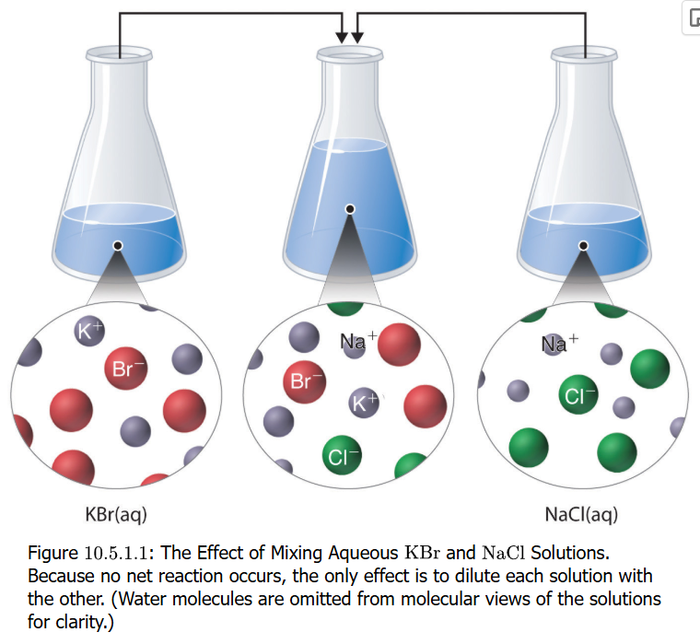
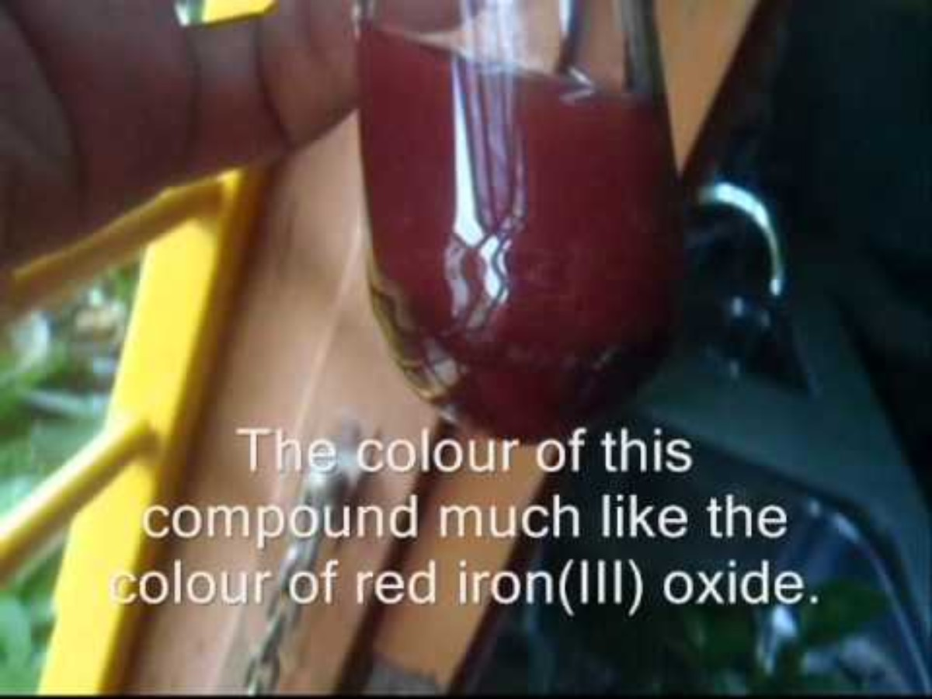
Precipitation Reactions
AC + BD → AD (s) + BC
Precipitations are double displacement reactions with one of products being insoluble
AgNO₃ (aq) + K₂Cr₂O₇ (aq) → Ag₂Cr₂O₇ (s) + KNO₃ (aq)
This is an unbalanced equation (can you balance it?)
Not all mixing of compounds in solutions results in precipitations
Mixing KBr and NaCl solutions results in no reaction except K⁺, Na⁺, Br–, and Cl– ions in solution, all at half original
concentrations

Slide 35
Practice: Precipitation Reactions
The 3 steps of the double displacement add a 4th step (actually at the 3rd step) to determine if a product is a precipitate according to solubility rules on your Green Sheet
Sr(OH)₂ (aq) is added to FeCl₂ (aq)
Exchange ions
Sr(OH)₂ (aq) + FeCl₂ (aq) → SrCl + Fe(OH)
Check exchanged ion charges, fix subscripts
Sr(OH)₂ (aq) + FeCl₂ (aq) → SrCl₂ + Fe(OH)₂
Both metals are 2+ ions, both anions 1–
Check solubility (precipitate) and note the phases
Sr(OH)₂ (aq) + FeCl₂ (aq) → SrCl₂ (aq) + Fe(OH)₂ (s)
Metal hydroxides like Fe are insoluble
Balance by finding coefficients
Sr(OH)₂ (aq) + FeCl₂ (aq) → SrCl₂ (aq) + Fe(OH)₂ (s)
Balancing not needed

Slide 36
Practice: Precipitation Reactions
K₃PO₄ solid added to mercury(II) perchlorate, Hg(ClO₄)₂ (aq)
Exchange ions
K₃PO₄ (aq) + Hg(ClO₄)₂ (aq) → K(ClO₄) + Hg(PO₄)
Check exchanged ion charges, fix subscripts
K₃PO₄ (aq) + Hg(ClO₄)₂ (aq) → KClO₄ + Hg₃(PO₄)₂
K⁺ matches ClO₄–, 3 Hg²⁺ needed for 2 PO₄³⁻
Check solubility (precipitate) and note the phases
K₃PO₄ (aq) + Hg(ClO₄)₂ (aq) → KClO₄ (aq) + Hg₃(PO₄)₂ (s)
Chlorates are soluble, phosphates of mercury are not
Balance by finding coefficients
2 K₃PO₄ (aq) + 3 Hg(ClO₄)₂ (aq) → 6 KClO₄ (aq) + Hg₃(PO₄)₂ (s)
Start with add 3 K to product side, then 3 Hg to reactant side; then see that 3 x 2 = 6 perchlorates are on reactant side, so put 6 in front of KClO₄; also need 2 PO₄ groups, so put 2 in front of K₃PO₄, verify that there are now 2 x 3 = 6 K on reactants and you see 6 x 1 = 6 K on products. DONE!

Slide 37
Practice: Precipitation Reactions
Solid sodium fluoride added to aqueous solution of ammonium formate
Exchange ions
NaF (aq) + NH₄OOCH (aq) → Na(OOCH) + (NH₄)F
Check exchanged ion charges, fix subscripts
NaF (aq) + NH₄OOCH (aq) → NaOOCH + NH₄F
All ions found to be 1+ or 1–
Check solubility (precipitate) and note the phases
NaF (aq) + NH₄OOCH (aq) → NaOOCH (aq) + NH₄F (aq)
Everything soluble, no precipitate
Balance by finding coefficients
NaF (aq) + NH₄OOCH (aq) → NaOOCH (aq) + NH₄F (aq)
No balancing was required in this step either

Slide 38
Practice: Precipitation Reactions
Mix aqueous solutions of calcium bromide and cesium carbonate
Exchange ions
CaBr₂ (aq) + Cs₂CO₃ (aq) → Ca(CO₃) + CsBr
Check exchanged ion charges, fix subscripts
CaBr₂ (aq) + Cs₂CO₃ (aq) → CaCO₃ + CsBr
The exchange actually matched +2 with -2, and +1 with -1
Check solubility (precipitate) and note the phases
CaBr₂ (aq) + Cs₂CO₃ (aq) → CaCO₃ (s) + CsBr (aq)
Carbonates are insoluble for Ca²⁺, bromides are soluble for Cs⁺
Balance by finding coefficients
CaBr₂ (aq) + Cs₂CO₃ (aq) → CaCO₃ (s) + 2 CsBr (aq)
Inspection shows Ca and CO₃ are balanced; add 2 to CsBr to balance Cs atom. The addition caused a balance of Br to the left; DONE

Slide 39
Acid-Base Neutralization
Acids react with bases to neutralize each other with the products being a salt and water
NaOH (aq) + HCl (aq) → NaCl (aq) + H₂O (l)
2 NaOH (aq) + H₂SO₄ (aq) → Na₂SO₄ (aq) + 2 H₂O (l)
Neutralize nitric acid with calcium hydroxide
Exchange ions
Ca(OH)₂ (aq) + HNO₃ (aq) → Ca(NO₃) (aq) + H₂O (l)
Check exchanged ion charges for product, fix subscripts
Ca(OH)₂ (aq) + HNO₃ (aq) → Ca(NO₃)₂ (aq) + H₂O (l)
Balance by finding coefficients
Ca(OH)₂ (aq) + 2 HNO₃ (aq) → Ca(NO₃)₂ (aq) + 2 H₂O (l)
Ca has one on both sides; next check H atom: 2 on right, 2 x 1 + 1 = 3 on left, so try putting 2 for HNO₃ making it 4 H atoms on left, so put 2 in front of H₂O on right; check N atoms: 2 on left and 2 on right (good); check O atoms: 2 x 1 + 3 x 2 = 8 on left, same check is good on right, DONE!

Slide 40
Practice: Acid-Base Neutralization
Hydrocyanic acid (HCN, cyanide gas) can be neutralized by potassium hydroxide (KOH)
Write a balanced chemical equation for the reaction between these two compounds and identify the salt that it produces
What donates the proton as the acid?
HCN
What is the base? What is its functional group?
KOH; hydroxide ion OH–
Neutralization forms what product in all acid-base reactions?
H₂O (water)
KOH (aq) + HCN (aq) ➔ KCN (aq) + H₂O (l)

Slide 41
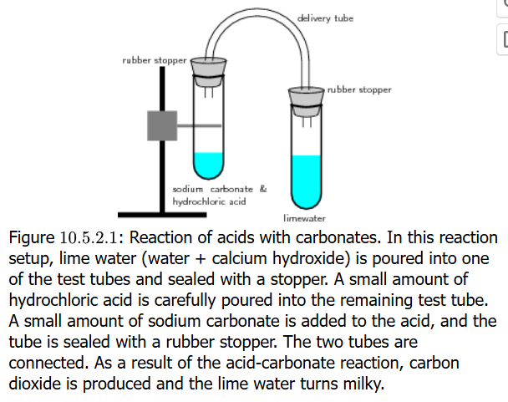
Gas-Evolving Reactions
Reactions of acids with carbonate salts usually produce a gas like carbon dioxide
2 HNO₃ (aq) + Na₂CO₃ (aq) → 2 NaNO₃ (aq) + CO₂ (g) + H₂O (l)
H₂SO₄ (aq) + CaCO₃ (aq) → CaSO₄ (aq) + CO₂ (g) + H₂O (l)
2 HCl (aq) + CaCO₃ (aq) → CaCl₂ (aq) + CO₂ (g) + H₂O (l)
In the figure on the right,
CO₂ created or released by the
addition of the carbonate salt
(Na₂CO₃) to dilute acid (HCl)
in the tube on the stand (left)
leaves the tube through the
stopper into tubing that connects
to a stoppered tube on the right
which contains calcium hydroxide
[Ca(OH)₂] on the right. Because
CaCO₃ is insoluble, a precipitate forms
making the solution milky

Slide 42
Gas-Evolving Reactions
Reactant Type | Intermediate Product | Evolved Gas | Example
sulfide | none | H₂S | 2 HCl (aq) + K₂S → H₂S (g) + 2 KCl (aq)
carbonates, bicarbonates | H₂CO₃ | CO₂ | 2 HCl (aq) + K₂CO₃ → H₂O (l) + CO₂ (g) + 2 KCl (aq)
sulfites, bisulfites | H₂SO₃ | SO₂ | 2 HCl (aq) + K₂SO₄ → H₂O (l) + SO₂ (g) + 2 KCl (aq)
ammonia | NH₄OH | NH₃ | NH₄Cl (aq) + KOH → H₂O (l) + NH₃ (g) + 2 KCl (aq)

Slide 43
Writing Equations for Reactions
There are three reaction equation types
molecular equation
  Your book calls it the complete chemical equation
  This shows all the compounds with ordinary chemical formula in the reaction, and it includes the phases in which the compounds exist
complete ionic equation
  All the compounds that exist in aqueous phase as ions are written in their ionic forms, with the phase (aq) shown next to them
  All the compounds that exist in the other phases (s, l, g) are written as they were written in the molecular equation
  It is important to note the ionic forms that are identical on both sides of the reaction arrow: these will be the spectator ions
net ionic equation
  The construction of this is simple: the spectator ions in the complete ionic equation are removed and what is left is the net ionic equation
  The net ionic equation is considered to be the meaningful reaction
It is important that in all three types of equations that every compound or ionic species written have the proper phase next to it

Slide 44
Writing Equations for Reactions
For the precipitation reaction of barium chloride mixed with sodium sulfate, it is written to illustrate the essence of the reaction. This is the molecular equation*
BaCl₂ (aq) + Na₂SO₄ (aq) → BaSO₄ (s) + NaCl (aq)
* Your textbook calls it complete chemical equation
But what really happens when compounds are dissolved in an aqueous solution is that compounds do not exist in this way but are dissolved as ions in solution
NOT ALL COMPOUNDS ARE IONS HOWEVER: if a product forms that is a gas (g), liquid (l), or solid (s), it is NOT shown as ions on the product side
This the complete ionic equation
Ba²⁺ (aq) + 2 Cl– (aq) + 2 Na⁺ (aq) + SO₄^{2–} (aq) → BaSO₄ (s) + 2 Cl– (aq) + 2 Na⁺ (aq)

Slide 45
Writing Equations for Reactions
Ba²⁺ (aq) + 2 Cl– (aq) + 2 Na⁺ (aq) + SO₄^{2–} (aq) →
BaSO₄ (s) + 2 Cl– (aq) + 2 Na⁺ (aq)
On the reactant and product sides, ions (Ba²⁺, Cl–, Na⁺, SO₄^{2–}) are present in dissolved form which you have determined to be the true form
Stoichiometry is preserved: BaCl₂ was solid, and it yielded Ba²⁺ and 2 Cl–. The same for Na₂SO₄: SO₄^{2–} and 2 Na⁺
Ba²⁺ and SO₄^{2–} are not shown on the product side as ions because they form a solid (precipitate) which is BaSO₄
Na⁺ and Cl– do not participate in the reaction and in effect cancel each other on both sides of the chemical equation or reaction arrow: these are spectator ions
The reaction can instead be written as a
net ionic equation as follows,
removing the spectator ions:
Ba²⁺ (aq) + SO₄^{2–} (aq) → BaSO₄ (s)

Slide 46
Aqueous Solutions of Ionic Compounds
Things to remember:
When putting typically solid ionic compounds in water to form an aqueous solution, does the ionic compound dissolve in any way?
What happens when you add Na2SO4 to water? What about BaSO4?
For adding multiple ionic compounds, does the mixture result in ions combining in all possible ways to form a precipitate?

Slide 47
Practice Writing Equations
For the precipitation reaction with AgNO₃ and CaCl₂, write the three equations: complete chemical equation, complete ionic equation, and net ionic equation
complete chemical equation
2 AgNO₃ (aq) + CaCl₂ (aq) → 2 AgCl (s) + Ca(NO₃)₂ (aq)
complete ionic equation
2 Ag⁺ (aq) + 2 NO₃– (aq) + Ca²⁺ (aq) + 2 Cl– (aq) →
2 AgCl (s) + Ca²⁺ (aq) + 2 NO₃– (aq)
net ionic equation
Ag⁺ (aq) + Cl– (aq) → AgCl (s)
Write the three equations (if needed) for Na₂SO₄ and NH₄I
complete chemical equation
Na₂SO₄ (aq) + NH₄I (aq) → NaI (aq) + (NH₄)SO₄ (aq)
complete ionic equation
2 Na⁺ (aq) + SO₄^{2–} (aq) + NH₄⁺ (aq) + I– (aq) →
2 Na⁺ (s) + SO₄^{2–} (aq) + NH₄⁺ (aq) + I– (aq)
net ionic equation
none: everything soluble, all spectator ions

Slide 48
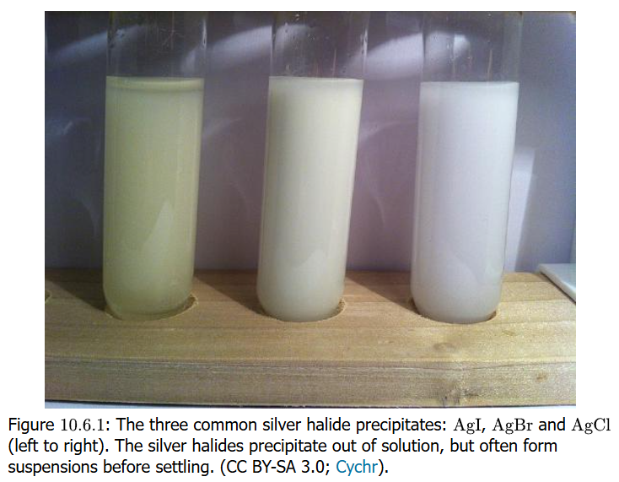
Writing Equations for Reactions
Precipitation reactions are often used to test the presence of ions in solution
Adding BaCl₂ to a solution and the formation of a precipitate could indicate sulfate (SO₄^{2–}) ion presence
Since Ba²⁺ can precipitate with other counter anions, how do we know it is BaSO₄? It is when the unknown solution is first acidified:
all precipitates of barium
dissolves in dilute acid but
not the sulfate
Halides of silver can be
distinguished by the color
of their precipitates when
AgNO₃ added to an acidified
unknown halide (image right)

Slide 49
Practice: Net Ionic Equations
Show the balanced net ionic equations
K₂CO₃ (aq) + SrCl₂ (aq) → Sr(CO₃) + KCl
2 K⁺ (aq) + CO₃^{2–} (aq) + Sr²⁺ (aq) + 2 Cl– (aq) → SrCO₃ (s) + 2 K⁺ (aq) + 2 Cl– (aq)
CO₃^{2–} (aq) + Sr²⁺ (aq) → SrCO₃ (s)
FeSO₄ (aq) + Ba(NO₃)₂ (aq) → BaSO₄ + Fe(NO₃)₂
Fe²⁺ (aq) + SO₄^{2–} (aq) + Ba²⁺ (aq) + 2 NO₃– (aq) → BaSO₄ (s) + Fe²⁺ (aq) + 2 NO₃– (aq)
SO₄^{2–} (aq) + Ba²⁺ (aq) → BaSO₄ (s)

Slide 50
Oxidation-Reduction Reactions
Also called REDOX reactions: “REDuction-OXidation”
Oxidation is when electrons are taken from an element/atom in a reaction (the redox reaction)
Reduction is when electrons are gained by an element/atom in a reaction (the redox reaction)
Both reactions MUST occur: when an element/atom is oxidized, another element/atom is reduced, and vice-versa
Both of these reactions are in fact
called half-reactions
Zn → Zn²⁺ + 2 e– (oxidation)
2 H⁺ + 2 e– → H₂ (reduction)

Slide 51
Half-Reactions
These are strictly related to oxidation and reduction reactions, shown as half-reactions because electrons (e–) are shown in the reactions
Oxidations involve the atom/compound giving up one or more electrons
X → X^{n+} + n e–
Reductions involve the atom/compound taking up one or more electrons
Z^{m+} + m e– → Z
Both in the (full) reactions and half-reactions, mass/matter/atoms/elements, electrical charge, and energy is ALWAYS conserved on both sides of the arrow

Slide 52
Gas-Evolving REDOX Reactions
Reactions of acids with metals also generate a gas:
2 HCl (aq) + Zn (s) → H₂ (g) + ZnCl₂ (aq)
This reaction is really a case of
oxidation of the metal
reduction of protons to form hydrogen gas
Zn → Zn²⁺ + 2 e– (oxidation)
2 H⁺ + 2 e– → H₂ (reduction)
Zn + 2 H⁺ → Zn²⁺ + H₂
Not all gas-evolving reactions are redox reactions (see slide 41)

Slide 53
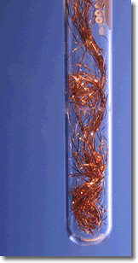

Oxidation-Reduction
Oxidation is a process that is attributed to observations of corrosion (“rusting”) and combustion
Reduction was a term applied to converting metal ores (salts of metals) to the pure metal, which involved a reduction in the mass of the ore
A copper wire in a silver nitrate solution will take on fuzzy or furry appearance and the solution
colored blue
Cu (s) + 2 AgNO₃ (aq) → Ag (s) + Cu(NO₃)₂ (aq)
Cu (s) + 2 Ag⁺ (aq) + 2 NO₃– (aq) →
2 Ag (s) + Cu²⁺ (aq) + 2 NO₃– (aq)
Cu (s) + 2 Ag⁺ (aq) → 2 Ag (s) + Cu²⁺ (aq)

Slide 54
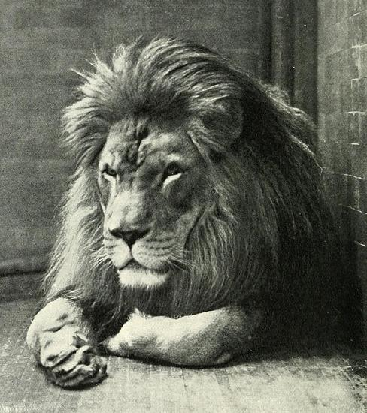
LEO / GER
Need a way to remember that
elements losing electrons is oxidation
and elements (usually OXYGEN)
gaining the electrons is reduction?
“LEO goes GER”
Loss of Electrons is Oxidation
Gain of Electrons is Reduction
“OIL RIG”
Oxidation Is Loss, Reduction Is Gain
Zn (s) + Fe²⁺ (aq) → Zn²⁺ (aq) + Fe (s)
Zinc gets oxidized and iron(II) gets reduced in the reaction. Zinc is a reducing agent and iron(II) is an oxidizing agent

Slide 55
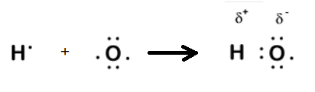
Electronegativity & Oxidation
Electronegativity is both a qualitative and quantitative indicator of how two elements with a covalent (shared electrons) bond will have one element pulling to itself more strongly those bonding electrons compared to the other element
While fluorine (F) is the most
electronegative of all elements,
oxygen (O) is 2nd and its
chemistry is vital for life
Oxygen’s ability to pull electrons
to itself from other elements like
hydrogen (H) gives it a special
place in chemistry to refer to its
properties as oxidation
Element | Electronegativity
Fluorine (F) | 3.98
Oxygen (O) | 3.44
Chlorine (Cl) | 3.16
Nitrogen (N) | 3.04
Bromine (Br) | 2.96
Hydrogen (H) | 2.20

Slide 56

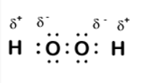
Oxidation Number
Ionic compounds are truly formed by ions in which one, typically metal element loses one or more electrons to become positively ionized (a cation) while another, typically nonmetal element gains one or more electrons to become negatively ionized (an anion)
The transfer of electrons forms the ionic compounds which differs from two nonmetal elements that form covalent bonds that range from have no bond dipole (no polarity) to having a significant bond dipole (noticeable polarity)
In water molecule, the hydrogen (H) atom
“loses” its one electron and oxygen (O) atom
“gains” that electron: H is oxidized to a +1
oxidation number. O has an oxidation number
of –2: this is because it takes one electron
each from the two H atoms it bonds to
In hydrogen peroxide (H₂O₂, H–O–O–H), both
O atoms have oxidation number of –1 because
they can take an electron from one H atom each

Slide 57
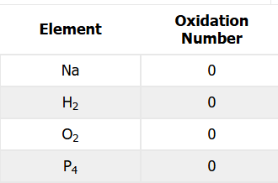
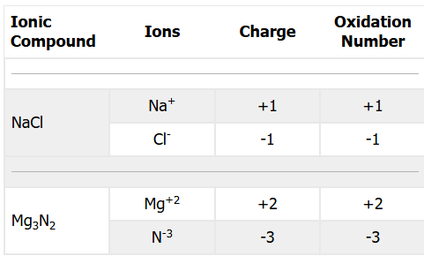
Oxidation Number Rules
There are a set of rules in determining
oxidation numbers for elements in
compounds
The oxidation number of a
pure element, whether
monatomic, diatomic or
polyatomic, is 0 (zero)
Oxidation number of a
monatomic ion is equal
to the charge of the ion.
Na⁺ is +1, Cl– is –1,
Mg²⁺ is +2, O^{2–} is –2

Slide 58
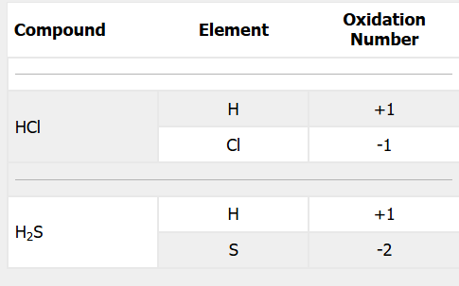
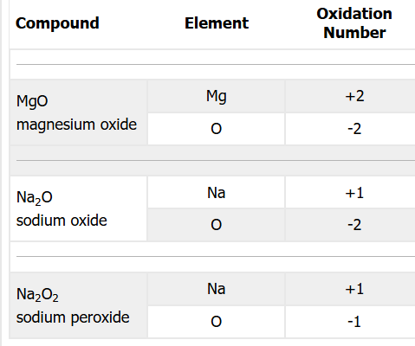
Oxidation Number Rules
The oxidation number of
hydrogen (H) is almost
always +1 when it is a
compound with a
nonmetal element. It is
–1 when a compound of
a metal cation as a metal
hydride.
Oxidation number of
oxygen (O) is usually –2 with
metals and most nonmetals.
Exceptions are in peroxide
(–O–O–) compounds: –1,
and if bonded to fluorine in
very highly reactive
oxygen difluoride (OF₂): +2
Compound | Element | Oxidation Number | Use
NaH | Na | +1
 | H | –1
NaBH₄ | Na | +1
 | B | +3
 | H | –1
LiAlH₄ | Li | +1
 | Al | +3
 | H | –1

Slide 59
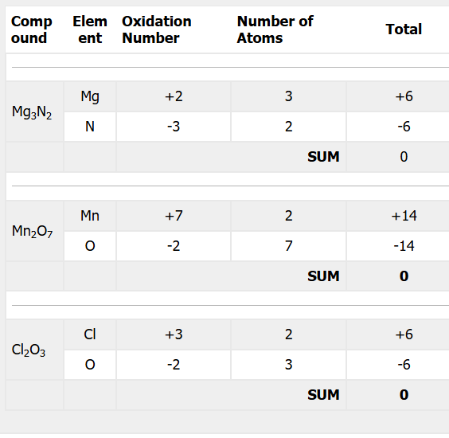
Oxidation Number Rules
Sum of all oxidation numbers in any compounds that has a zero charge is zero
This means that atoms with a negative oxidation number will add to a total negative value and
atoms with positive oxidation number
will add to a total where the overall
sum is zero
Mn₂O₇ is the example:
From the O=–2 rule, with
7 O atoms for –14 total
electrons, and with
2 Mn atoms, the Mn oxidation
number = +14/2 = +7

Slide 60
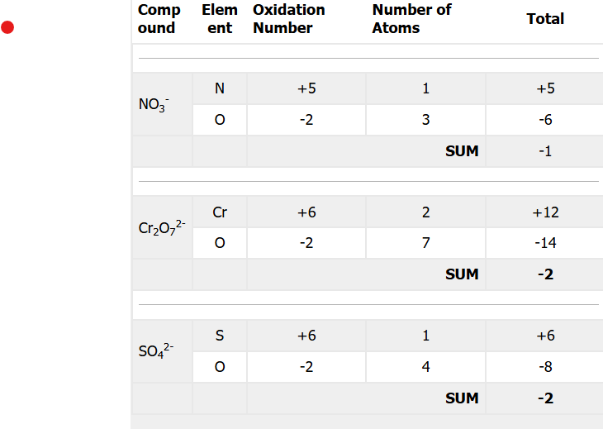
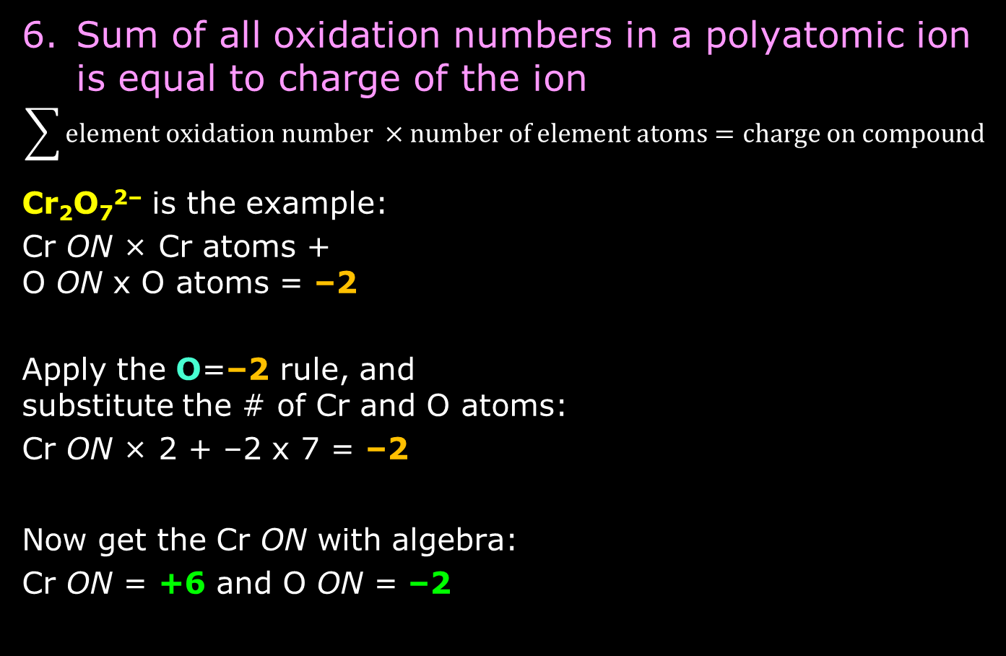
Oxidation Number Rules
Sum of all oxidation numbers in a polyatomic ion is equal to charge of the ion
$$\sum{element oxidation number ×number of element atoms=charge on compound }$$
Cr₂O₇^{2–} is the example:
Cr ON × Cr atoms +
O ON x O atoms = –2
Apply the O=–2 rule, and
substitute the # of Cr and O atoms:
Cr ON × 2 + –2 x 7 = –2
Now get the Cr ON with algebra:
Cr ON = +6 and O ON = –2

Slide 61
Oxidation State / Oxidation Number
The term oxidation state is sometimes encountered
Many references in literature indicate that
oxidation state is synonymous with oxidation number
Oxidation number is the present-day term
Feature | Oxidation Number | Oxidation State
Definition | A formal charge assigned by rules (electrons go to the more electronegative atom). | The actual or effective charge on an atom based on electron distribution in bonding.
Purpose | Bookkeeping for redox reactions; consistent across all compounds. | Describes the real chemical environment, especially in coordination complexes.
How it’s assigned | Algorithmic rules (O = –2, H = +1, sum = 0, etc.). | Based on ligand type, covalency, and electron donation/withdrawal.
Uniqueness | Always a single integer. | Can be ambiguous or fractional in delocalized systems.
Where differences matter | Rare in simple molecules; important in transition‑metal chemistry. | Especially important in coordination chemistry and materials chemistry.
Example where they differ | In Fe(CO)₅, oxidation number of Fe = 0 by rules. | Oxidation state is still considered 0, but electron donation/backbonding makes the actual electron density on Fe higher than the formal number suggests.

Slide 62
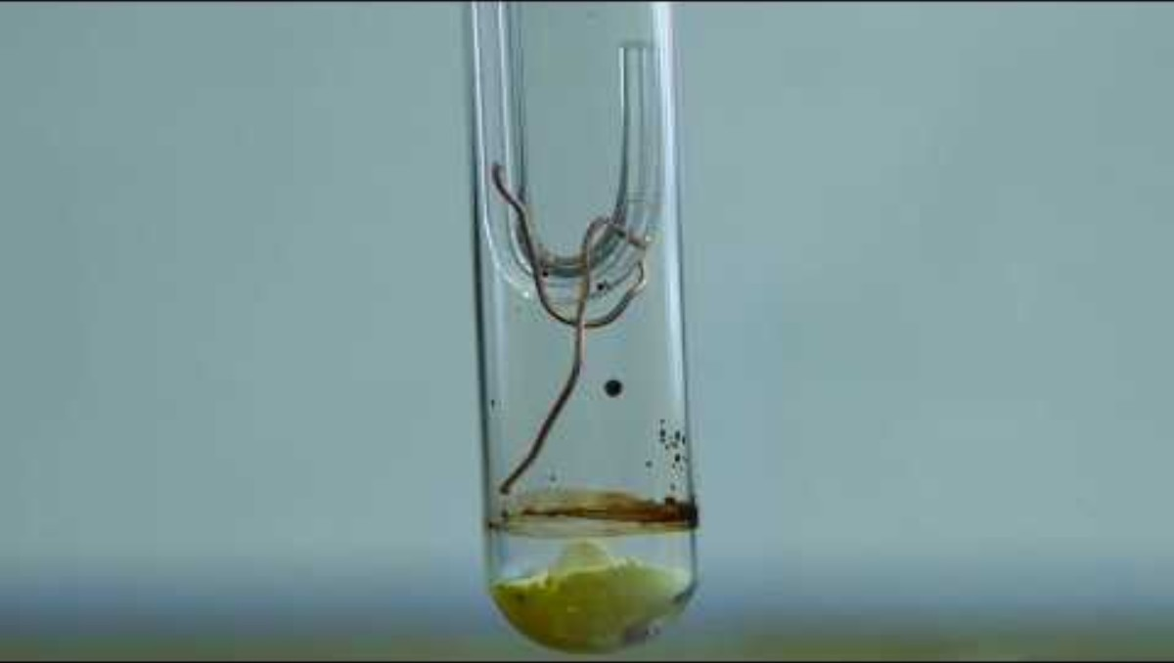
The Copper Wire Sulfur Powder Experiment
Remember Lab Expt 4a “Law of Constant Composition”
Copper wire reacting with sulfur was a redox reaction
Copper atoms lose one
electron each (oxidation)
Sulfur atoms gain two
electron each (reduction)
Half-reactions
:: 2 Cu → 2 Cu⁺ + 2 e–
:: S + 2 e– → S^{2–}
2 Cu (s) + S (s) → Cu₂S (s)

Slide 63
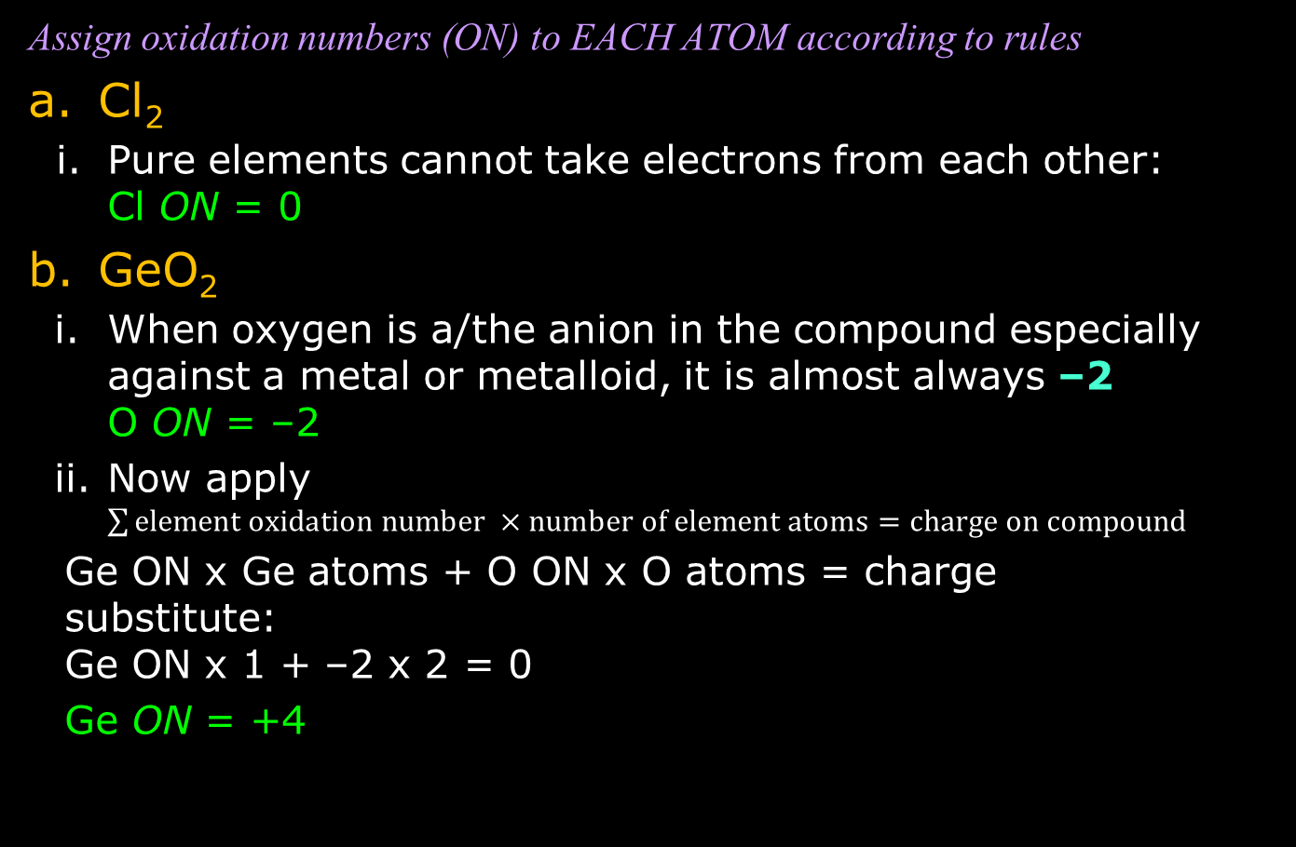
Practice: Oxidation Numbers
Assign oxidation numbers (ON) to EACH ATOM according to rules
Cl₂
  Pure elements cannot take electrons from each other:
  Cl ON = 0
GeO₂
  When oxygen is a/the anion in the compound especially against a metal or metalloid, it is almost always –2
  O ON = –2
  Now apply $\sum{element oxidation number ×number of element atoms=charge on compound }$
  Ge ON x Ge atoms + O ON x O atoms = charge
  substitute:
  Ge ON x 1 + –2 x 2 = 0
  Ge ON = +4

Slide 64
Practice: Oxidation Numbers
Assign oxidation numbers (ON) to EACH ATOM according to rules
Ca(NO₃)₂
  The ON of a metal ion particularly in Group 1 and 2 elements is the charge of its ion. Ca²⁺ → Ca ON = +2
  NO₃ is a polyatomic ion with total –1 charge (thus NO₃– is how it is represented), so the sum of the oxidation numbers on three O atoms and one N atom must be –1.
  Oxygen has an ON = –2 according to rules, and there are three of them (O ON = –2). This totals a –6 charge.
  To determine the nitrogen ON, it must be part of the polyatomic ion NO₃⁻, so N ON + (–6) = –1, or N ON = +5
  Solving for N ON another way—the better way:
  Ca ON x Ca atoms + N ON x N atoms +
  O ON x O atoms = compound charge
  1 x (+2) + N ON x 2 + (-2) x 6 = 0
  N ON = —[1 x (+2) + (-2) x 6] / 2 = –[2 + (–12)] /2 = +5

Slide 65
More Practice: Oxidation Numbers
Assign oxidation numbers (ON) to EACH ATOM according to rules
H₃PO₄
  ON of hydrogen in a compound with nonmetal monatomic or polyatomic group is +1 . H ON = +1
  Oxygen has an ON = –2 according to rules: O ON = –2
  Now solve for the P ON
  H ON x H atoms + P ON x P atoms + O ON x O atoms = compound charge
  (+1) x 3 + P ON x 1 + (-2) x 4 = 0
  P ON = —[(+1) x 3 + (-2) x 4] = –[3 + –8] = +5
MgO
  One rule states that metal cations of Groups 1 and 2 have ON which is the charge of the ion. Mg2+ → Mg ON = +2
  Oxygen has an ON = –2 according to rules: O ON = –2

Slide 66
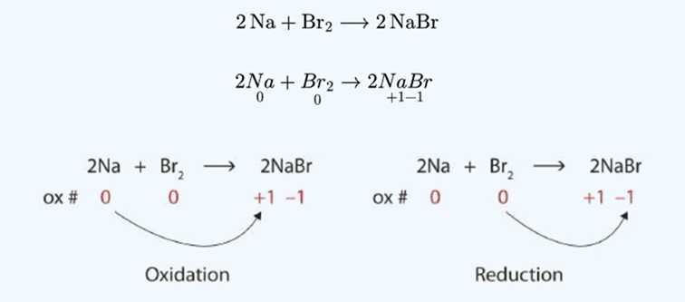
If There Is Oxidation, There is Reduction
Just as there is conservation of mass/matter and of energy, there is a conservation of electric charge
Electric charge and oxidation numbers/states must balance on both sides of the chemical reaction equation
Where there is an oxidation, there is a reduction
Where there is element/atom oxidized, another element/atom is reduced

Slide 67
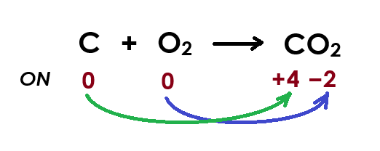

What’s Being Oxidized? What’s Reduced?

Slide 68
Combustion Reactions
Make it balanced
Strategy
If combustion, then CO₂ (if carbon present) and H₂O are products!
Balance the oxidized main atom (C, H, etc) on products’ side
Balance additional non-O atom (like H) on products’ side
Count O atoms on products’ side
  If is an ODD number of O atoms, multiply everything by 2
  If EVEN number (before or after doing [a]), put coefficient in front of O₂ on reactants
H₂ (g) + O₂ (g) → ?
2 H₂ (g) + O₂ (g) → 2 H₂O (g)
C₃H₈ (g) + O₂ (g) → ?
C₃H₈ (g) + 5 O₂ (g) → 3 CO₂ (g) + 4 H₂O (g)
C₆H₁₄ (l) + O₂ (g) → ?
2 C₆H₁₄ (l) + 19 O₂ (g) → 12 CO₂ (g) + 14 H₂O (g)

Slide 69
Redox Reactions as Two Half-Reactions
With oxidation-reduction (redox) reactions, they are special in the way that they are expressed as two half-reactions
Because there is not only mass but charge (shown as “e–” or electrons), both mass (atom kind & number) and charge must balance (be conserved) on both sides of the arrow
You normally write the oxidation (loss of electrons, the electron-producing) half-reaction first
Follow with the reduction (gain of electrons, electron-consuming) half-reaction after
Mg (s) + Cl₂ (g) → MgCl₂ (s)
  Write oxidation reaction: Mg → Mg²⁺
  Balance it with charge (electrons): Mg → Mg²⁺ + 2 e–
  Write reduction reaction: Cl₂ → 2 Cl–
  Balance it with charge (electrons): Cl₂ + 2 e– → 2 Cl–
  Check if the electrons cancel in the half-reactions: yes
  Write the full reaction: Mg + Cl₂ → Mg²⁺ + 2 Cl–
  Associate with original reaction: Mg + Cl₂ → MgCl₂

Slide 70
More Examples of Two Half-Reactions
Cu (s) + AgNO₃ (aq) → Cu(NO₃)₂ (aq) + Ag (s)
  Write oxidation reaction: Cu → Cu²⁺
  Balance it with charge (electrons): Cu → Cu²⁺ + 2 e–
  Write reduction reaction: Ag⁺ → Ag
  Balance it with charge (electrons): Ag⁺ + 1 e– → Ag
  Check if the electrons cancel in the half-reactions: no, need to multiply silver reduction by 2: 2 Ag⁺ + 2 e– → 2 Ag
  Write the full reaction: Cu + 2 Ag⁺ → Cu²⁺ + 2 Ag
  Associate with original reaction: Cu + 2 AgNO₃ → Cu(NO₃)₂ + 2 Ag

Slide 71
More Examples of Two Half-Reactions
This redox is more complex, and it will explain why it requires an acid solution to make it happen
MnO₄– (aq) + Fe²⁺ (aq) + H⁺ (aq)→ Mn²⁺ (aq) + Fe³⁺ (aq) + H₂O (l)
  Write oxidation reaction: Fe²⁺ → Fe³⁺
  Balance it with charge (electrons): Fe²⁺ → Fe³⁺ + 1 e–
  Reduction is different: Mn ON goes from +7 to +2
  Write reduction reaction: MnO₄– → Mn²⁺
  Why don’t we write it as Mn⁷⁺ → Mn²⁺?
  Balance ON with charge (electrons): MnO₄– + 8 H⁺ + 5 e– → Mn²⁺ + 4 H₂O
  Have to write H⁺ and H₂O in reaction. O atoms required because of MnO₄–
  Check if the electrons cancel in the half-reactions: no, need to multiply Fe oxidation by 5: 5 Fe²⁺ → 5 Fe³⁺ + 5 e–
  Write the full reaction: 5 Fe²⁺ + MnO₄– + 8 H⁺ → 5 Fe³⁺ + Mn²⁺ + H₂O

Slide 72
More Examples of Two Half-Reactions
This redox also happens in acid solution necessarily
HNO₃ (aq) + Cu (s) + H⁺ (aq)→ NO₂ (g) + Cu²⁺ (aq) + H₂O (l)
  Write oxidation reaction: Cu → Cu²⁺
  Balance it with charge (electrons): Cu → Cu²⁺ + 2 e–
  Reduction is different: N ON goes from +5 to +4
  Write reduction reaction: HNO₃ → NO₂
  Balance ON with charge (electrons): HNO₃ + H⁺ + e– → NO₂ + H₂O
  Have to write H⁺ and H₂O in reaction. O atoms required because of HNO₃
  Check if the electrons cancel in the half-reactions: no, have to multiply the reduction half-reaction by two: 2 HNO₃ + 2 H⁺ + 2e– → 2 NO₂ + 2 H₂O
  Write the full reaction: Cu (s) + 2 HNO₃ + 2 H⁺ → Cu²⁺ + 2 NO₂ + 2 H₂O

Slide 73
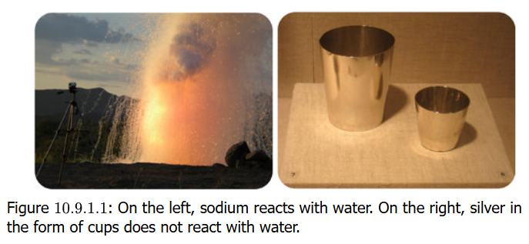
Activity Series
Both silver (Ag) and sodium (Na) can be oxidized (Ag → Ag⁺ + e–, Na → Na⁺ + e–)
But Na metal will react with cold water and Ag metal is completely unreactive
The activity series for elements that show this redox reactivity has been drawn to the Periodic Table on the next slide.
There are explanations/reasons for the patterns of the reactivity but they are
beyond scope of this course

Slide 74
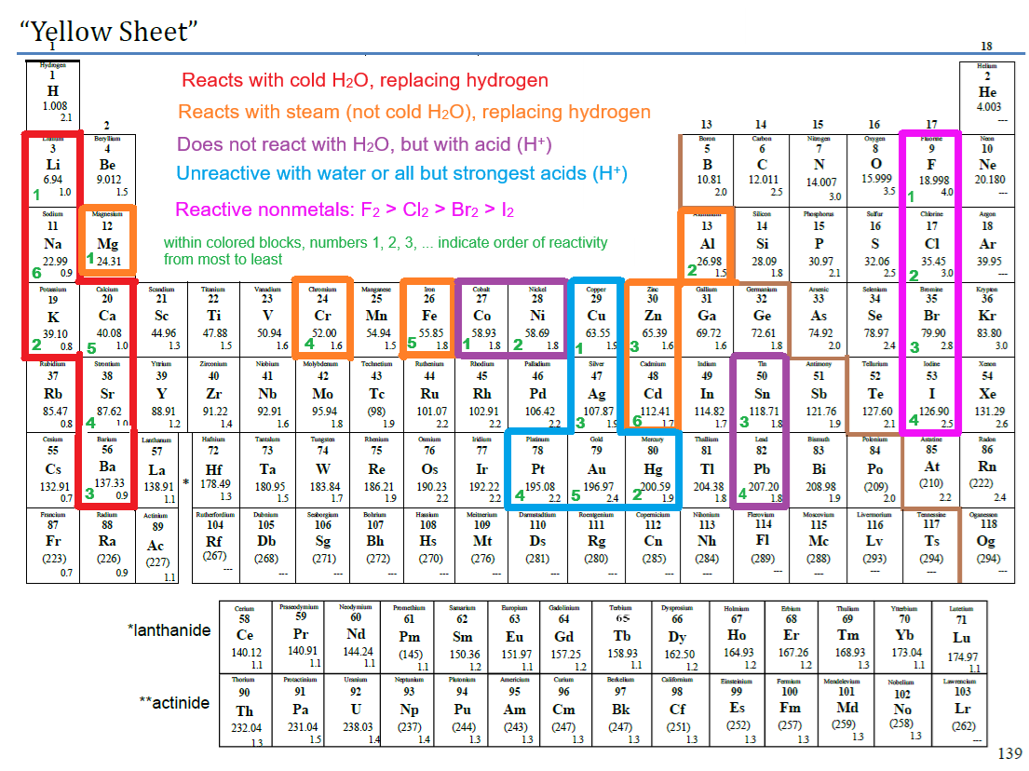

Slide 75
Practice: Activity Series
Use the information from the Activity series shown in the drawn Periodic Table to make predictions about reaction
Al (s) + Zn(NO₃)₂ (aq) → ?
Yes: 2 Al (s) + 3 Zn(NO₃)₂ (aq) → 2 Al(NO₃)₃ + 3 Zn (s)
Ag (s) + HCl (aq) → ?
No: Ag will not react with dilute acid
FeCl₂ (aq) + Zn (s) → ?
Yes: Zn is more reactive than Fe and can be oxidized
FeCl₂ + Zn → Fe + ZnCl₂
HNO₃ (aq) + Au (s) → ?
No: gold unreactive with even acids of moderate strength

Slide 76
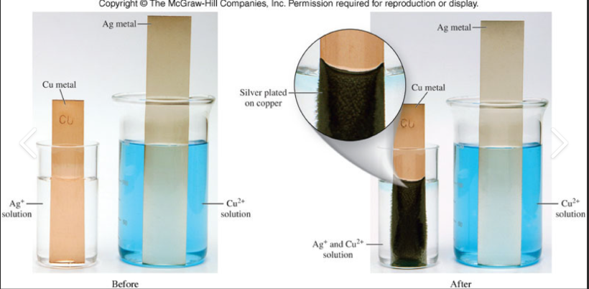
Chemistry Related to Batteries
Batteries used in electronic devices are basically containers of chemicals that react to produce electrons that enable electric current. These reactions are redox reactions
Reactions like the oxidation of copper in a silver solution are the basis for the chemistry:
2 Ag⁺ (aq) + Cu (s) → 2 Ag (s) + Cu²⁺ (aq)

Slide 77
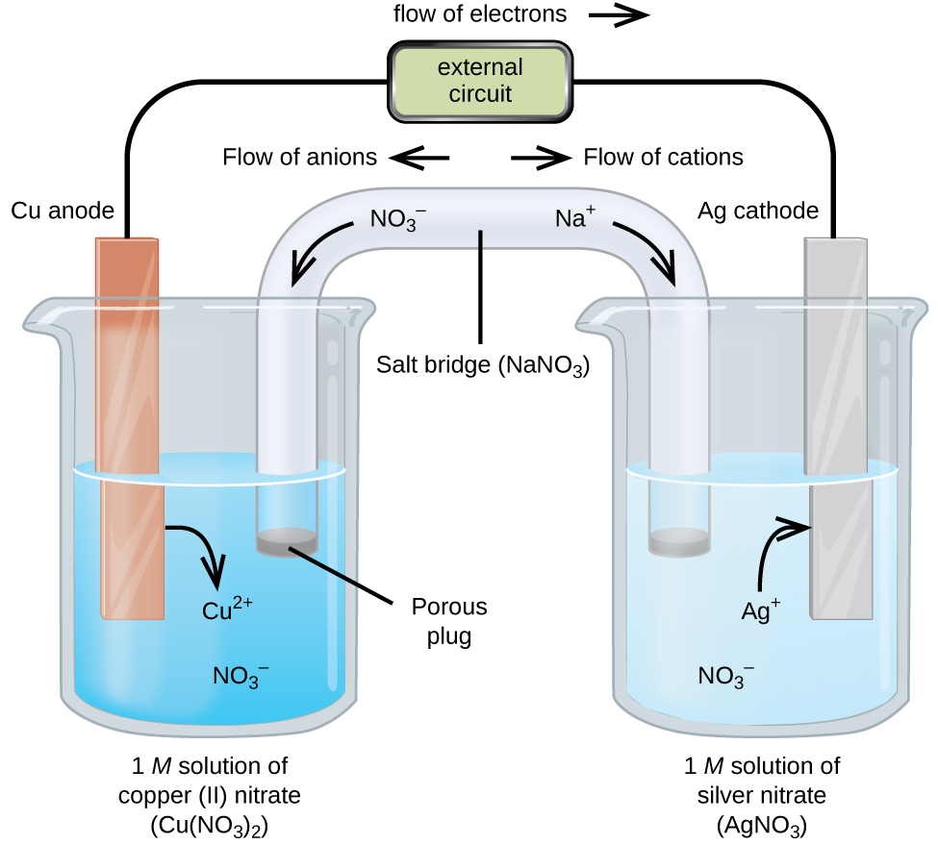
Silver-Copper Galvanic Cell
Instead of wasting the electron flow from copper metal to silver solution, set up a compartmentalized solid copper/copper solution and solid silver/silver solution and connect these as a circuit with a wire to a device to be powered, and “salt bridge” of sodium nitrate
The electrode where
reduction occurs is the
cathode (electrons gained)
The electrode where
oxidation occurs is the
anode (electrons lost)

Slide 78
Anode or Cathode?
AN OX: Anode is for Oxidation (loss of electrons)
RED CAT: Reduction happens at the Cathode (gain of electrons).
Memory trick: Picture a red cat doing chemistry, or a massive ox named An Ox.
The Vowel / Consonant Trick (For Current Flow)
If you look at the first letters:
Anode starts with a vowel (A) and points to Oxidation (also a vowel).
Cathode starts with a consonant (C) and points to Reduction (also a consonant).
Direction of Positive and Negative Ions (Anions & Cations)
If you forget which ions go where, look at their names:
Anions (negative ions) are attracted to the Anode (positive).
Cations (positive ions) are attracted to the Cathode (negative).
For Batteries in Use (Galvanic / Voltaic Cells)
Think of a standard battery powering a device (like a flashlight or remote):
PANIC: Positive Anode, Negative In Cell?
For galvanic cells, it's actually the opposite:
NEG-AN (Negative Anode) and POS-CAT (Positive Cathode).
An easier trick for galvanic cells is CAR: Cathode is Positive, Anode is Negative in a discharging battery

Slide 79
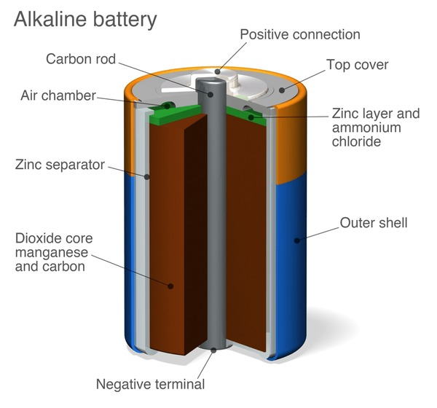
Dry Cell Battery
Your nonrechargeable A, AA, AAA batteries are dry cell type
Zn case is anode (neg pole), graphite rod is cathode (pos pole)
A paste of either MnO₂, NH₄Cl, ZnCl₂ or KOH electrolyte (alkaline type)
Cathode:
2 MnO₂ (s) + 2 NH₄⁺ (aq) + 2 e– →
Mn₂O₃ (s) + H₂O (l) + 2 NH₃ (aq)
Anode:
Zn (s) → Zn²⁺ (aq) + 2 e–

Slide 80
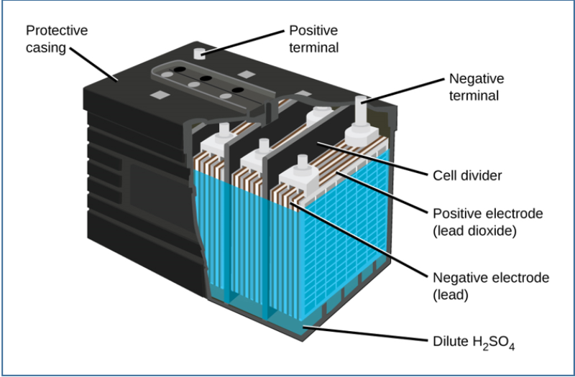
Storage Batteries
The classic type is the rechargeable lead-acid automobile battery. Anode is grid of Pb-Sb or Pb-Ca alloy packed with spongy lead; cathode in lead(IV) oxide, in sulfuric acid electrolyte
Cathode:
PbO₂ (s) + 4 H⁺ (aq) + 2 e–
→ PbSO₄ (s) + 2 H₂O (l) +
2 NH₃ (aq)
Anode:
Pb (s) + SO₄^{2–} (aq) →
PbSO₄ (s) + 2 e–

Slide 81
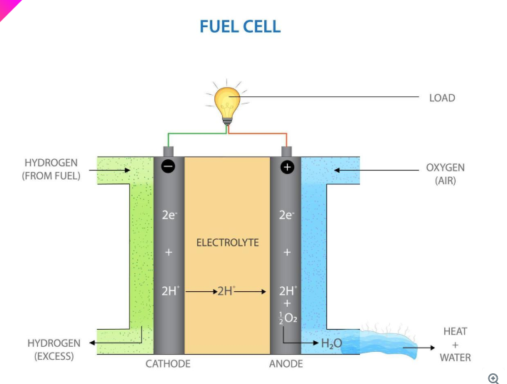
Fuel Cells
Works by continuously streaming H₂ and O₂ gas in the presence of a catalyst in a KOH electrolyte
Cathode:
O₂ (g) + 2 H₂O (l) + 4 e– → 4 OH– (aq)
Anode:
2 H₂ (g) + 4 OH– (aq) → 4 H₂O + 4 e–
Net: 2 H₂ (g) + O₂ (g) → 2 H₂O (l)

Slide 82
Corrosion
Falls in category of “undesirable” redox reactions
The rusting of iron (Fe) is one such reaction
Fe (s) → Fe²⁺ (aq) + 2 e–
H₂O (l) + ½ O₂ (g) + 2 e– → 2 OH– (aq)
Further oxidation to Fe³⁺ occurs, and this reacts with OH– ions to form iron(III) oxide [Fe₂O₃] and also iron(III) hydroxide [Fe(OH)₃]
Prevention?
Put paint, grease, plastic to cover the metal and prevent O₂ from getting access
Put Zn or Mg on iron surface: they are more readily oxidized and Fe keeps its integrity. Sacrificial anodes in water heaters work this way

